Slide 1
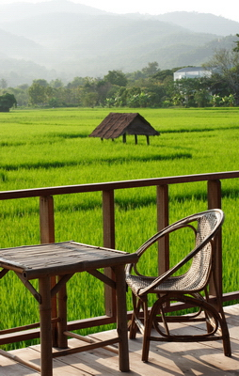
Migration to the countryside:
New class dynamics in peri-urban Thailand
去城还乡：泰国城郊地区阶级新动态
Tubtim Tubtim
RCSD, Chiang Mai University
杜丁，泰国清迈大学
社会科学与可持续发展区域研究中心研究员
Notes:
Case study
– Chiang Mai, northern Thailand – hubs of all facilities and beauty of nature and culture
-- the big change was about 30 years ago when cold war in SEA was finished and the Thai govt at that time announced changing battle field to market
→ Movement of people – local people migrated to work in the city and abroad; speed of development (construction /transportation); investment /speculation
-- Today the landscape of the area has changed – no migration out to work but lots of migration in to work and reside which each group has different aims
SCOPE
-- peri-urban zone of Chiang Mai – macro scale of the area + a case study of community in the area
-- People might think the area is not rural anymore BUT
Agricultural landscape
The long-resident villagers have been formed under rural context – community, values
The urban middle class newcomers have moved into the area mostly to search for a non urban setting (busy, crowded, individualistic,...)
APPROACH
-- the case is my own community where I have lived since 2007 as one of the in-migrant groups therefore I have had opportunities to observe and reflect from the field especially on everyday practice of interaction between social/class groups. At the same time, in my analysis and writing, I am aware of my position and make it clear to my informants that it is my research and also put myself in the writing

Slide 2
Content 内容
Peri-urban: characteristics and its dynamism 城市郊区：特性与动态
Migration to the countryside: situation and search for the “countryside” 去城还乡：基本情况与对“田园牧歌式乡村”的向往
Class in the studies of agrarian change:
Past and Present 农政变迁研究中的阶级：过去与现在
Understanding class and rural-urban interaction 理解阶级与城乡互动

Slide 3
Study of peri-urban in SE Asia
东南亚的郊区研究
Desakota - Terry McGee et.al 乡城过渡区-特里·麦吉等（1991）
Confined to large metropolitan regions 发展囿于大都会区的限制
Under-studied: falling between urban and rural 对介于城市和乡村之间的地带研究远远不足
Yet, peri-urban area is the most dynamic 然而，郊区是最富有动态性的

Slide 4
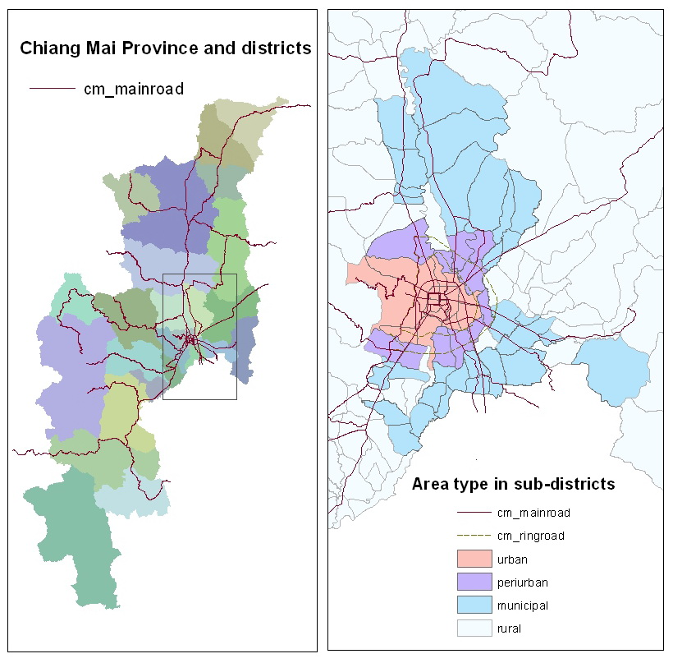
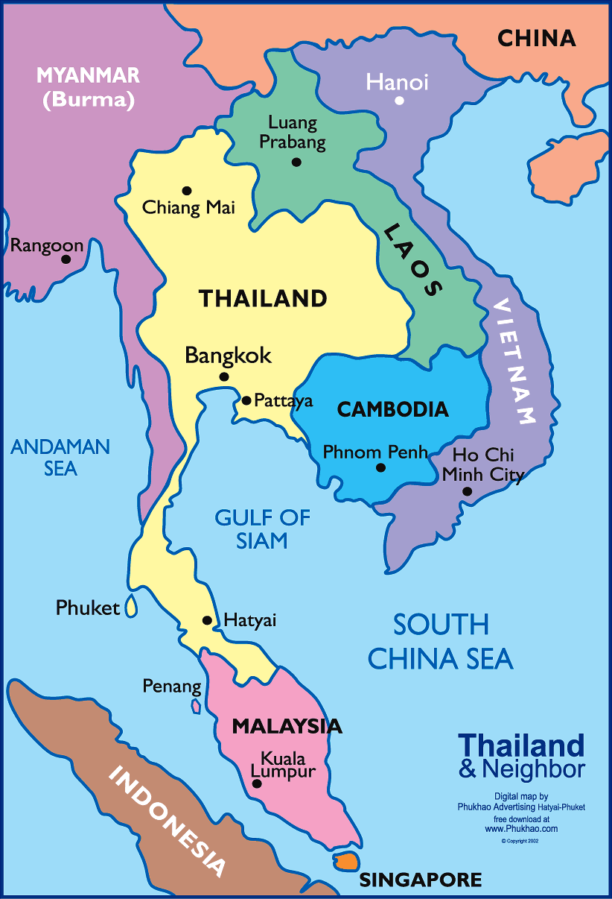
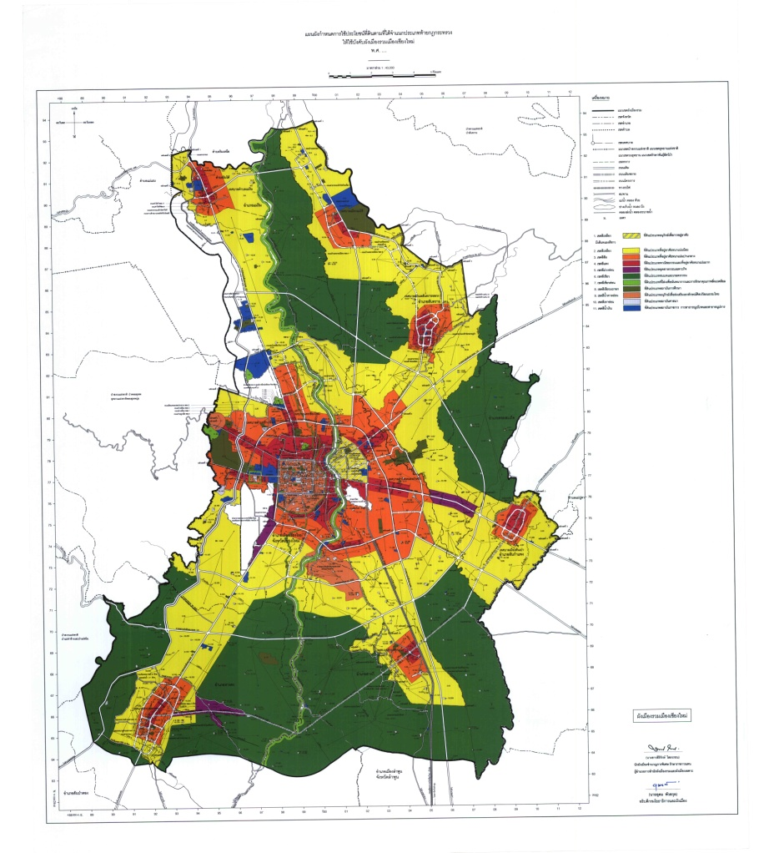
The peri-urban case study
郊区个案研究：清迈
Notes:
Case study
– Chiang Mai, northern Thailand – hubs of all facilities and beauty of nature and culture
-- the big change was about 30 years ago when cold war in SEA was finished and the Thai govt at that time announced changing battle field to market
→ Movement of people – local people migrated to work in the city and abroad; speed of development (construction /transportation); -- Today the landscape of the area has changed – no migration out to work but lots of migration in to work and reside which each group has different aims
SCOPE
-- People might think the area is not rural anymore BUT
Agricultural landscape
The long-resident villagers have been formed under rural context – community, values
The urban middle class newcomers have moved into the area mostly to search for a non urban setting (busy, crowded, individualistic,...)
APPROACH
-- the case is my own community where I have lived since 2007 as one of the in-migrant groups therefore I have had opportunities to observe and reflect from the field especially on everyday practice of interaction between social/class groups.

Slide 5
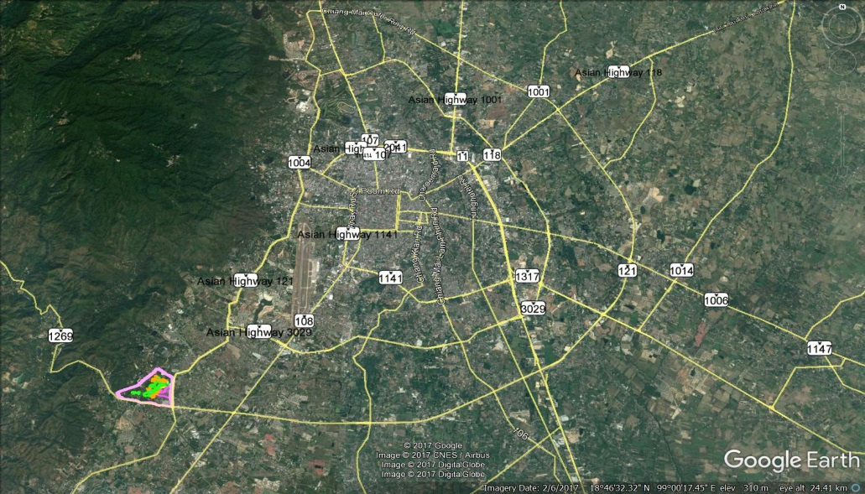
Location of the case study
案例位置

Slide 6
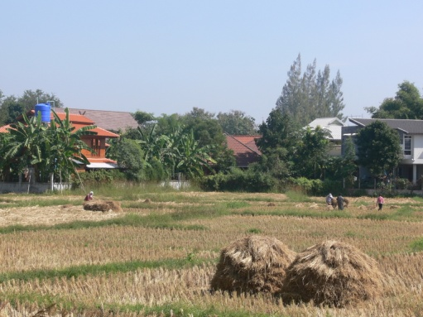
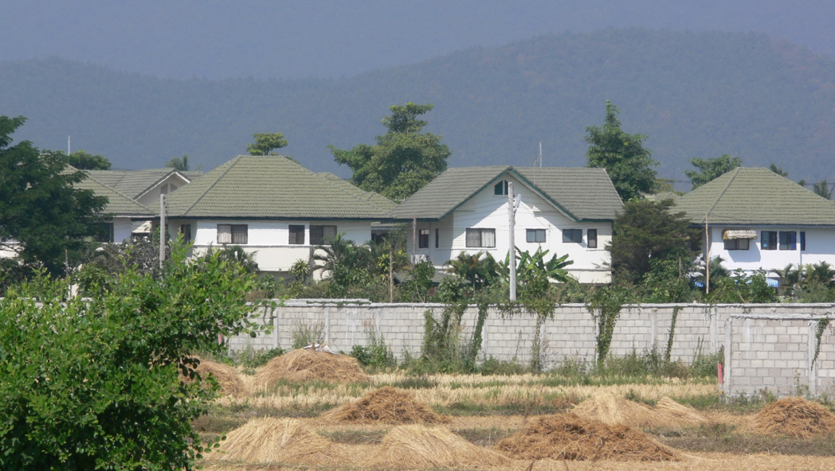
Study the Peri-urban area
研究郊区
Area of transition 过渡区域
Post-agrarian context: agrarian changes and urban expansion 后农耕环境：农政变迁与城市扩张
From out-migration to in-migration 从迁出到迁入
Peri-urban village as a place of class encounters 郊区村庄是不同阶级之间遭遇的场所

Slide 7
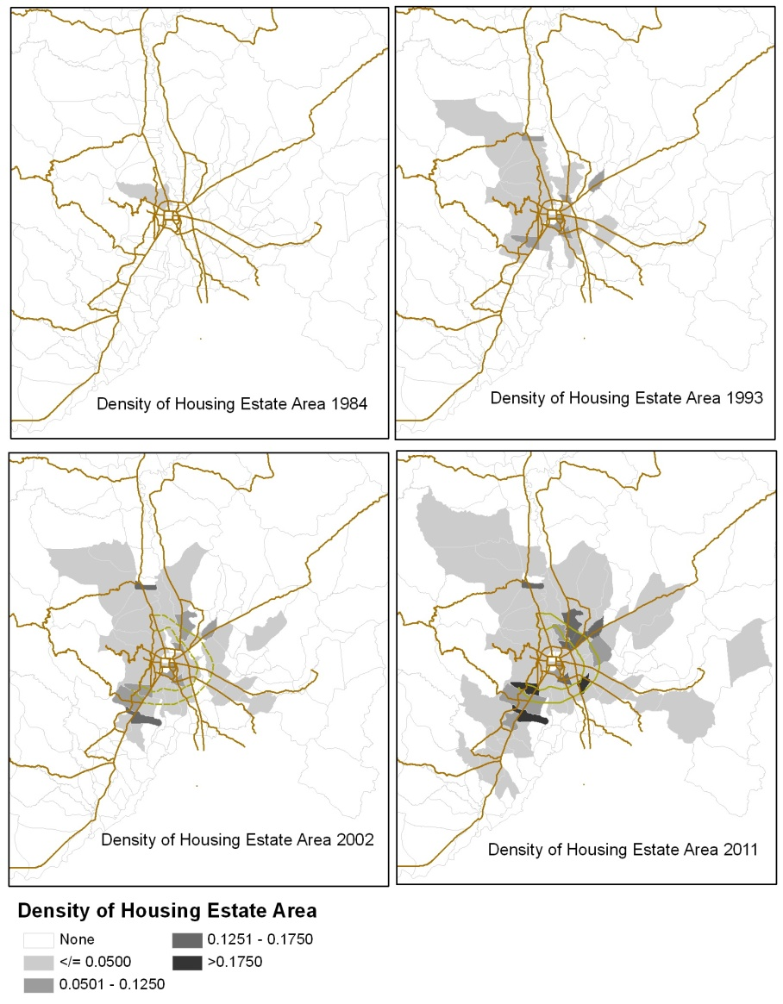
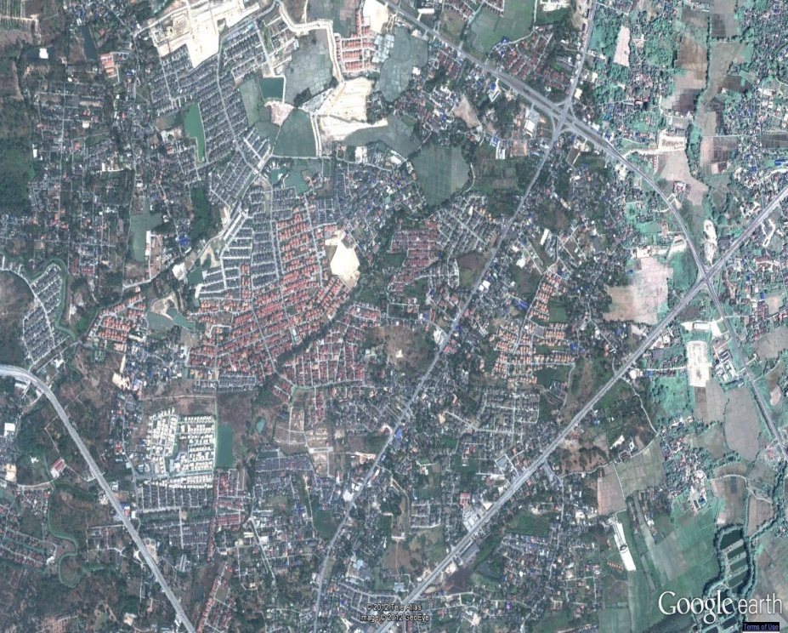

Macro Level: Urban expansion
宏观层次：城市扩张
Notes:
What are the patterns of migration in peri-urban Chiang Mai , and what are the desires of each social group?

Slide 8
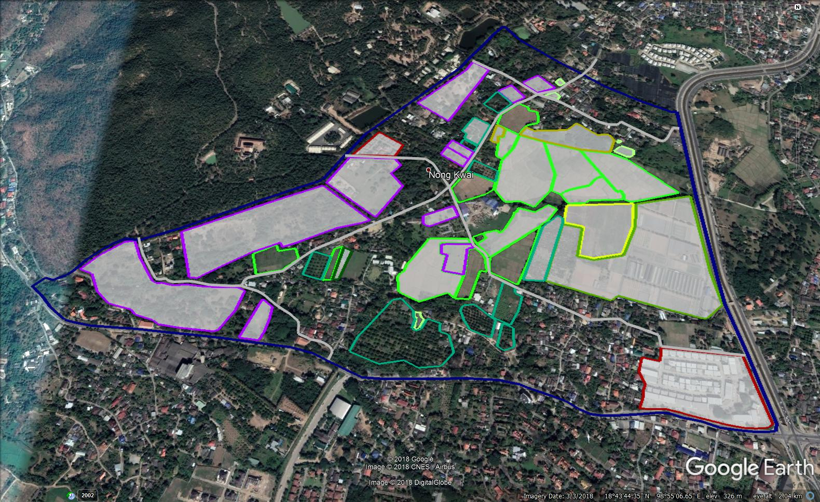
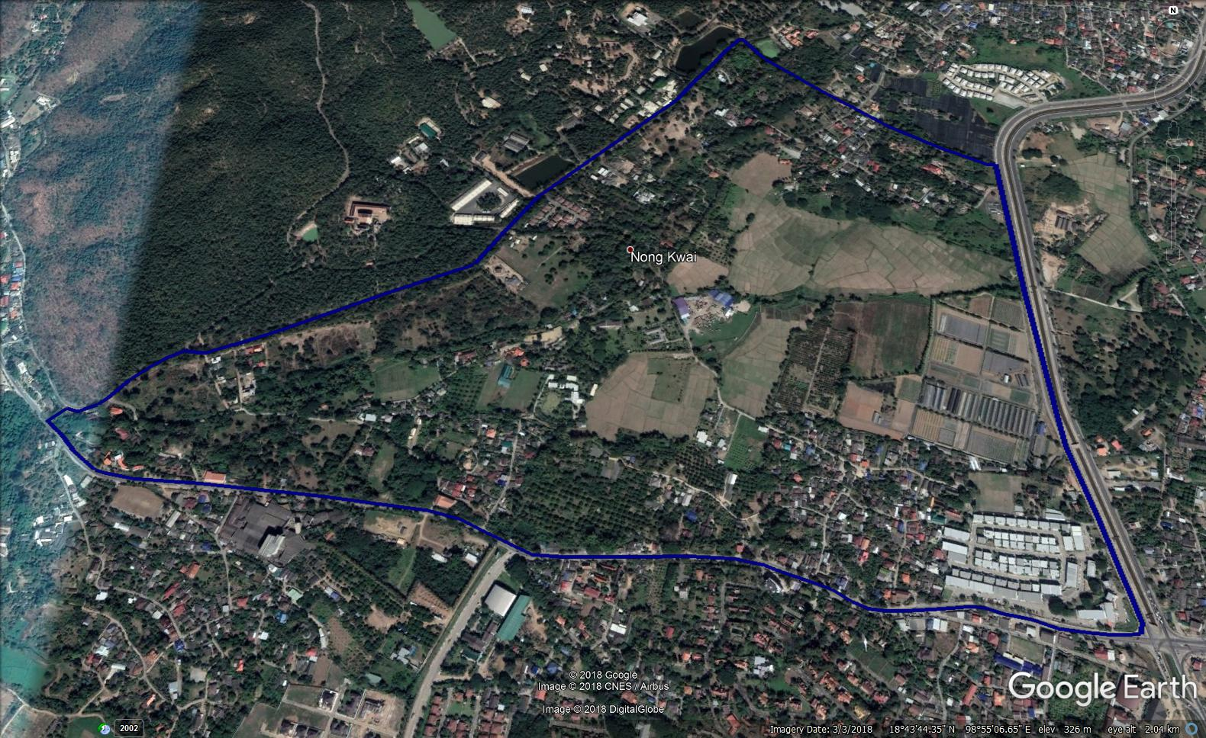
Micro level: Changes of land uses
微观层次：土地利用的变化

Slide 9
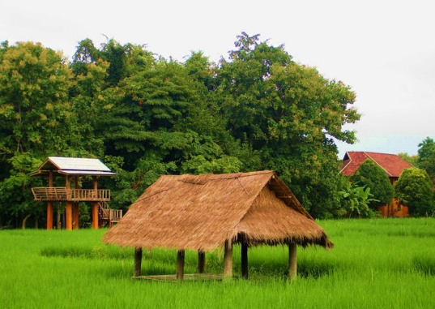
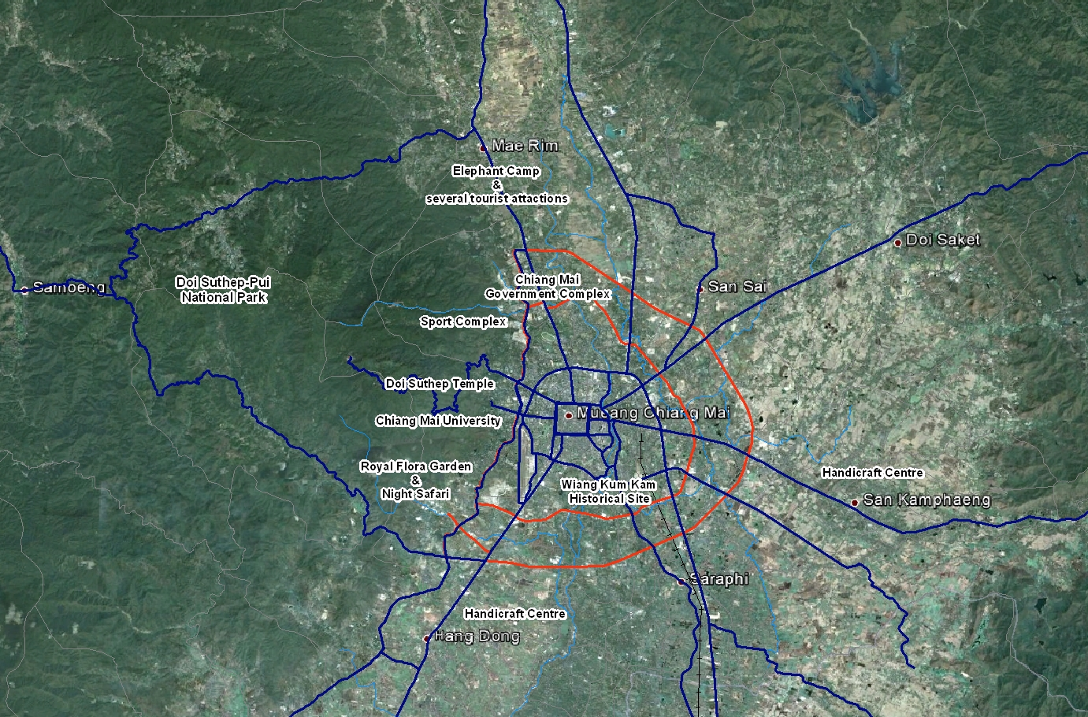
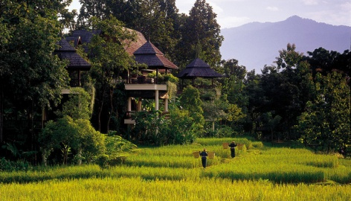
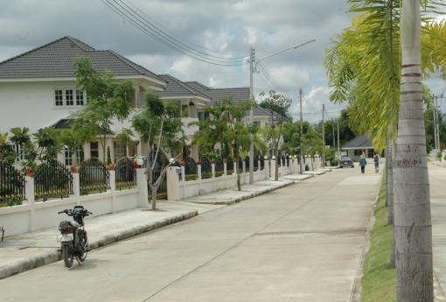
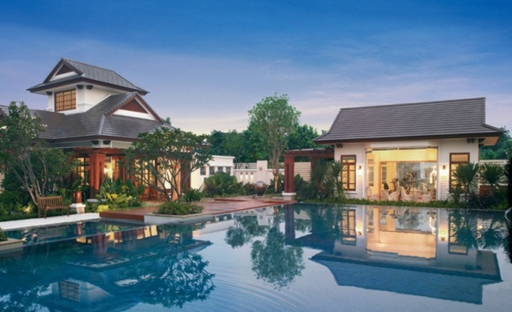
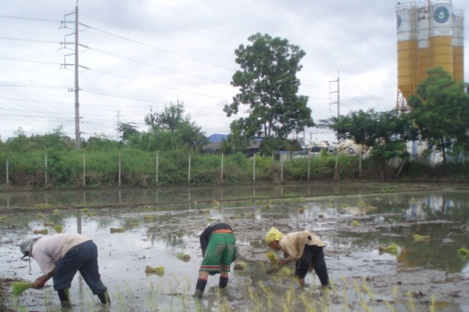
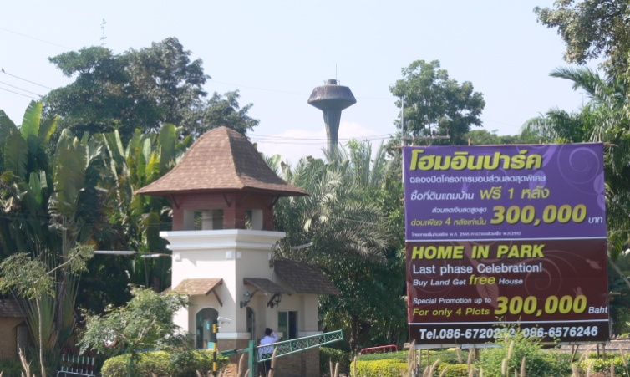
Migration to the countryside
移向乡村
Notes:
Changes from inside and outside through in-migration
Class/group that has more ability possesses better location and views according to their classes

Slide 10
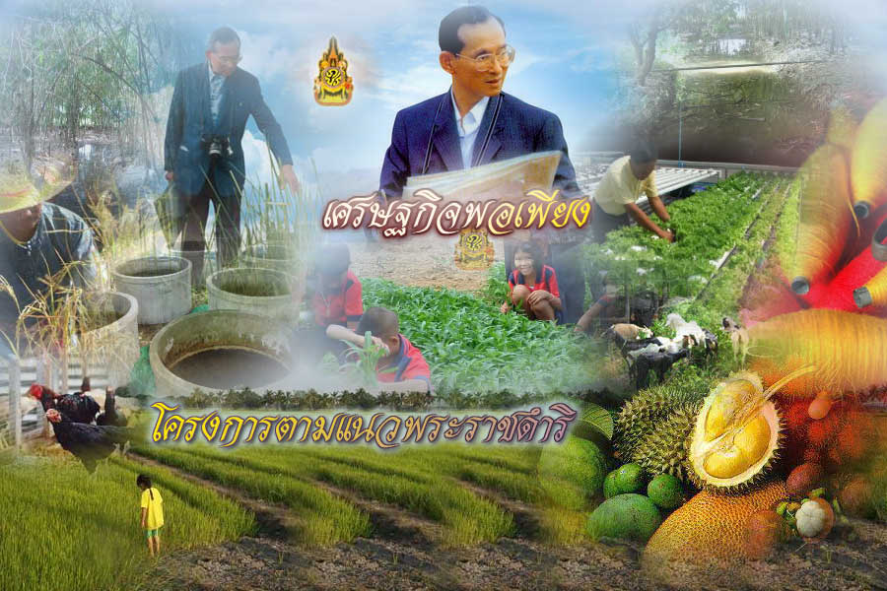
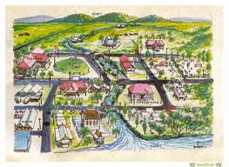


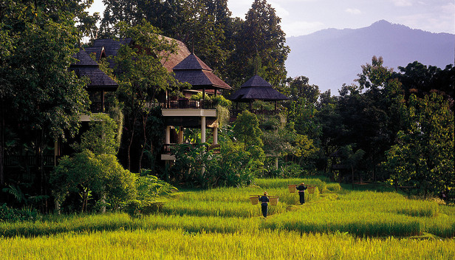
Representation of the Thai “countryside”
泰国“乡村”的象征
Notes:
Representation of Thai countryside from all mass media
– textbooks, literature, film, TV program, royal project – sufficiency economy, tourism
Urban middle class who have understanding and expectation towards the countryside - meanings of rurality - as countryside and community - represented and understood by different groups in the village and in the public media

Slide 11
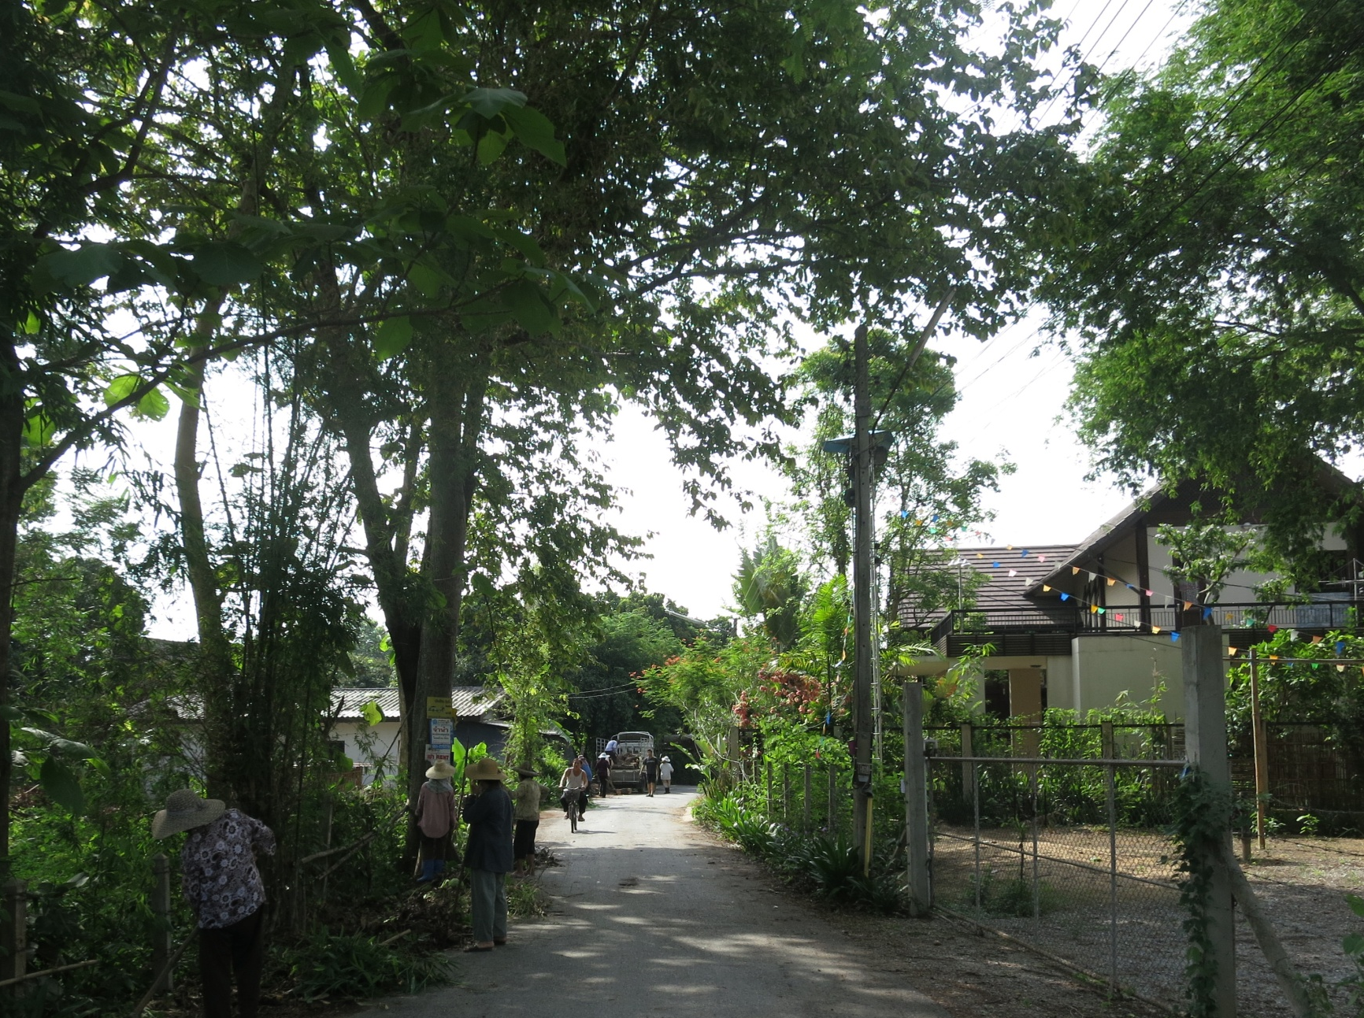
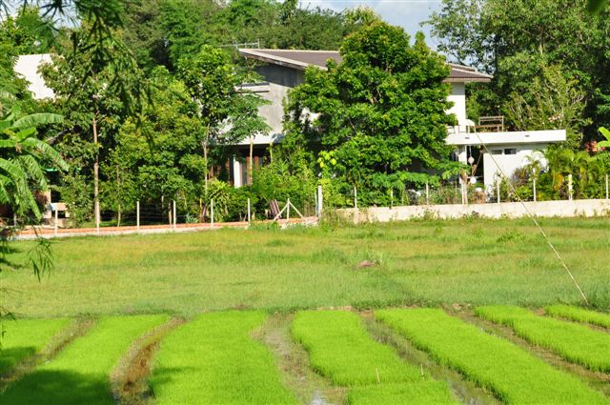
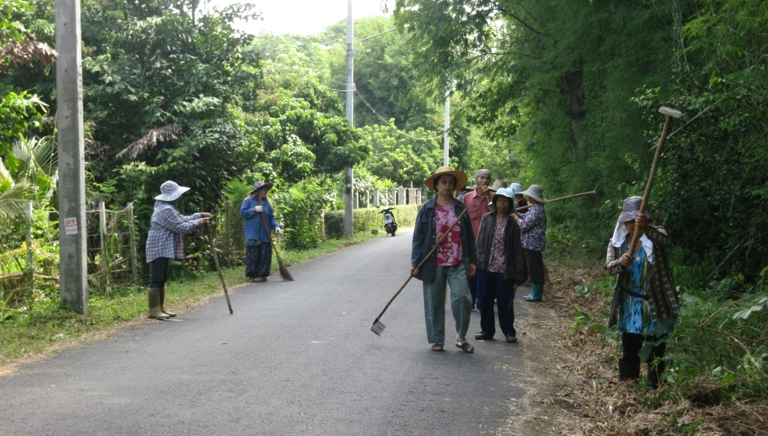
In-migration: search for the countryside
迁入：找寻田园牧歌式乡村

Slide 12
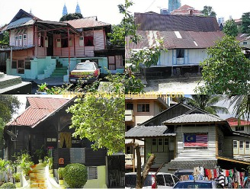
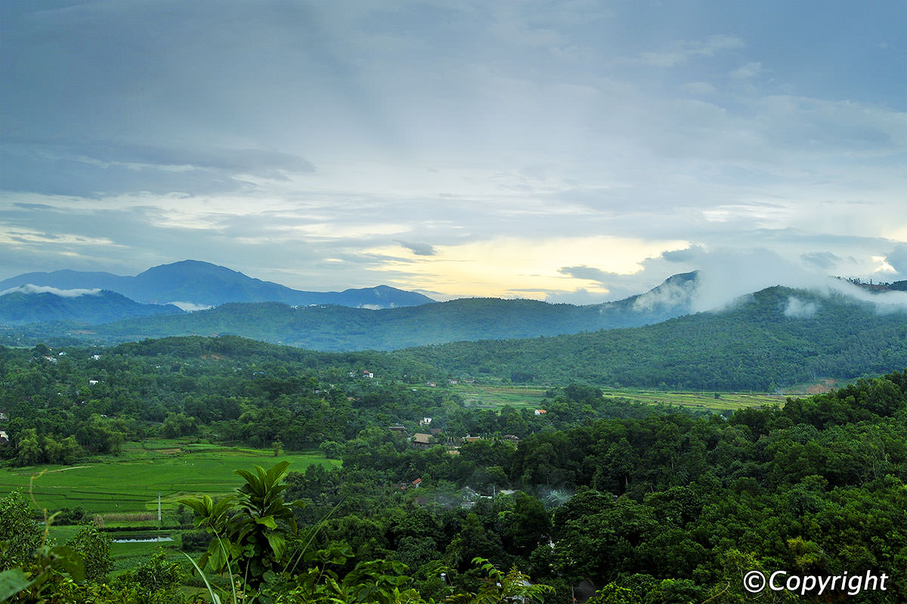
Understanding class and rural-urban interaction
理解阶级和城乡互动
Kampung in Malaysia 甘榜（传统）村落，马来西亚 | Bavi in Hanoi, Vietnam 巴威，越南河内
Chiang Mai, Thailand 泰国清迈
Notes:
Class and rural-urban interaction
Malaysia – Kampung may still look like local farming community but people’s livelihoods already urban. Economic activity is based around works outside agriculture → spaces of Kampung have become “socially urban”
Vietnam – Urban people have second homes in a mountainous area of Hanoi through land speculation. They claim for nostalgia of traditional village life. But they do not have intention to interact with local community
Chiang Mai – the penetration of urban influences shown in media, touristic place and this high-end hotel. Their interests are not very much how rural livelihoods or their problems are but rather its selective representation

Slide 13
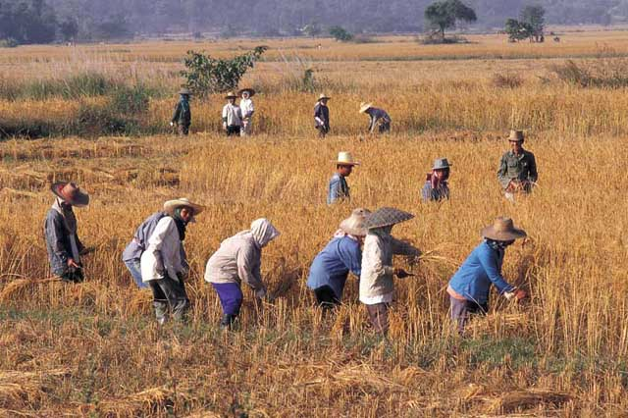
Study of class in a changing context
变迁环境中的阶级研究
Notes:
Class in agrarian context in the past
Means of production: land, labour, and capitals in production
Class is a relational term – discussing social stratification
Agricultural society was not complex and people were related around farming and production

Slide 14
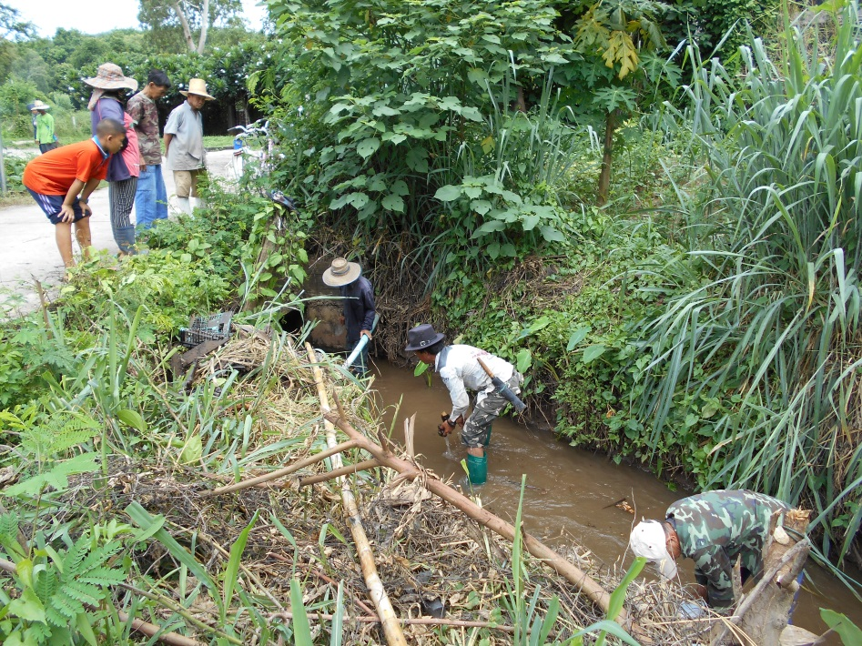
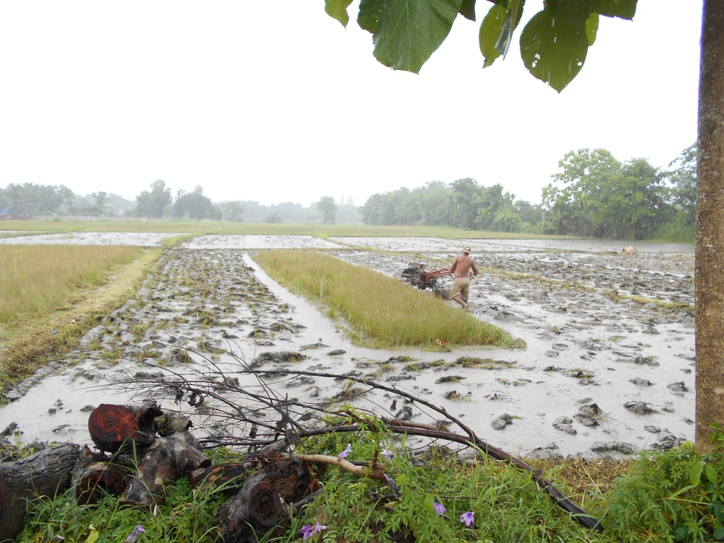
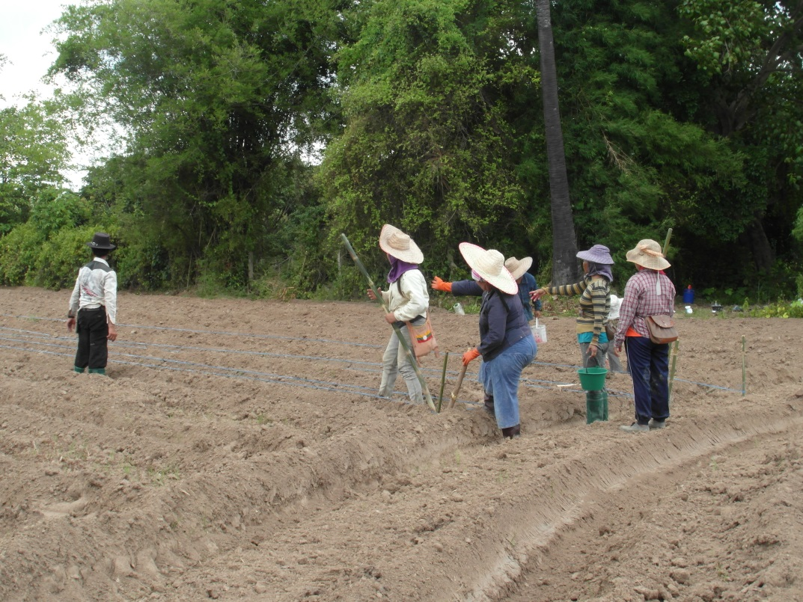
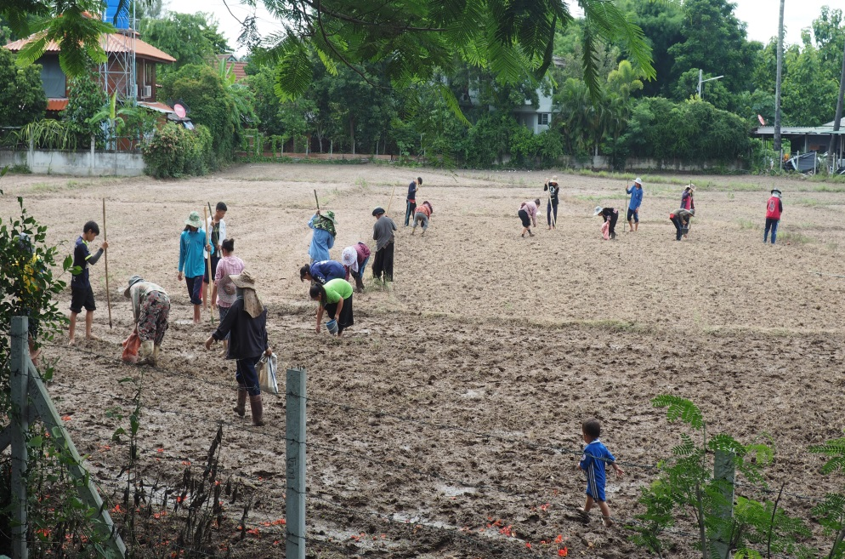
Uses of labour in farming activities
农耕活动中的劳动力使用

Slide 15
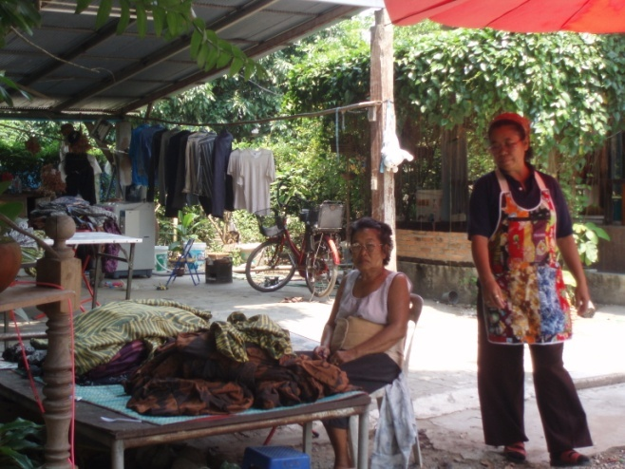
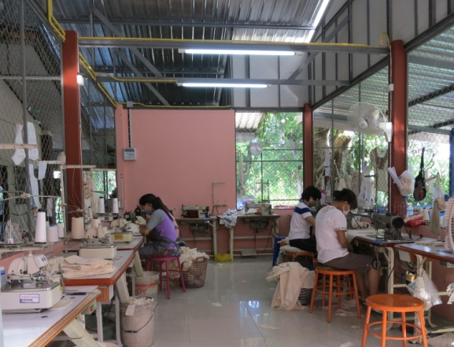
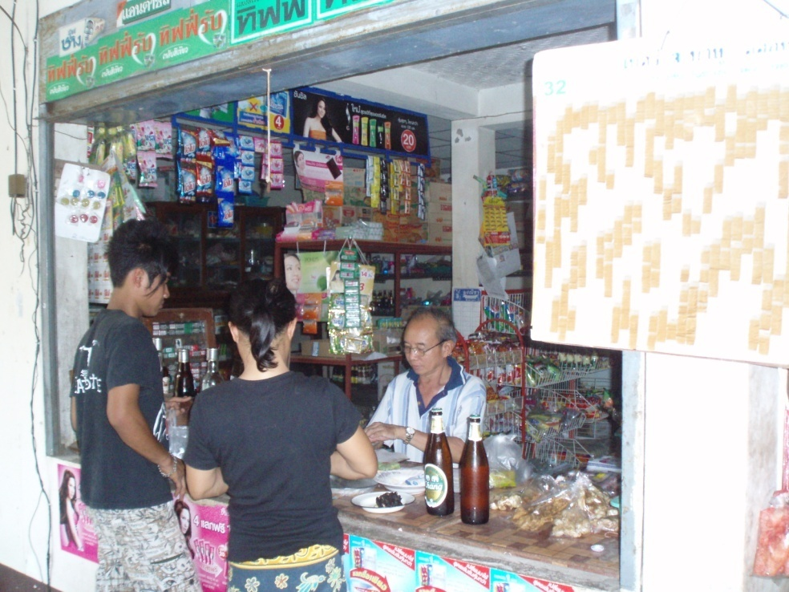
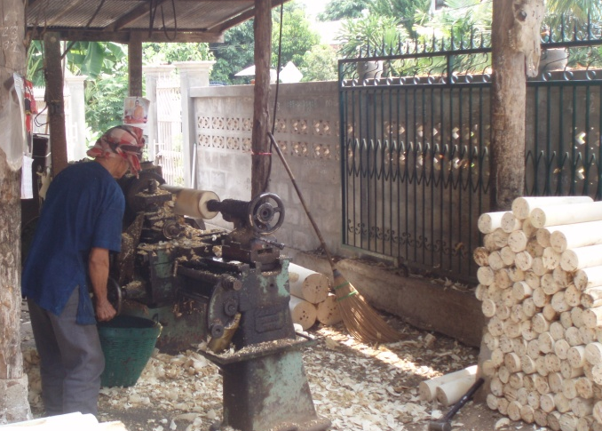
Class mobility from within
社区内部的阶级流动
Notes:
Class mobility from within
in the past all people were farmers w/ some are labours in the farm as land was limited
During the development – migration + sold land; facility development in the area → people have been gradually out of the farm
Better economic capital during the development and change to become small entrepreneur, dormitories owners, construction contractors
education in the younger generation most of children got undergrad degree and many have master degree
some are not better and class between local people have become clearer

Slide 16
Different social groups in the small community
40 permanent and 51 temporary households
社区中的不同社会群体 ，40个永久家户和51个暂居家户
泰国城市中产
10%
1 family
缅甸工人
16%
常住村民
32%
寄宿工人
40%
Notes:
Changing social landscape through class – change from class based on agrarian relations and production to class based on values, habitus, background, education, language

Slide 17
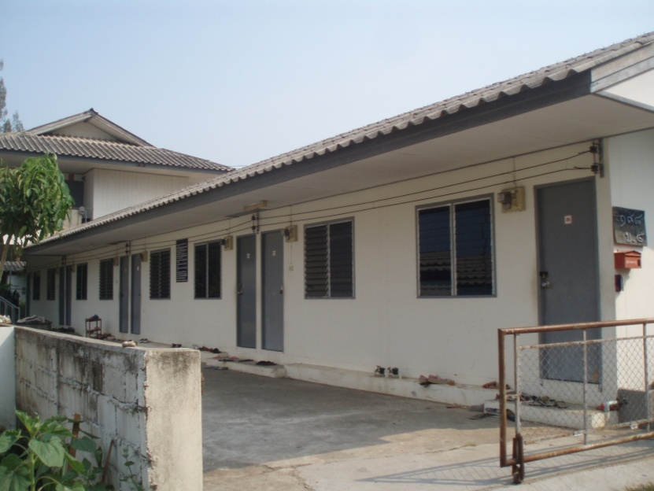
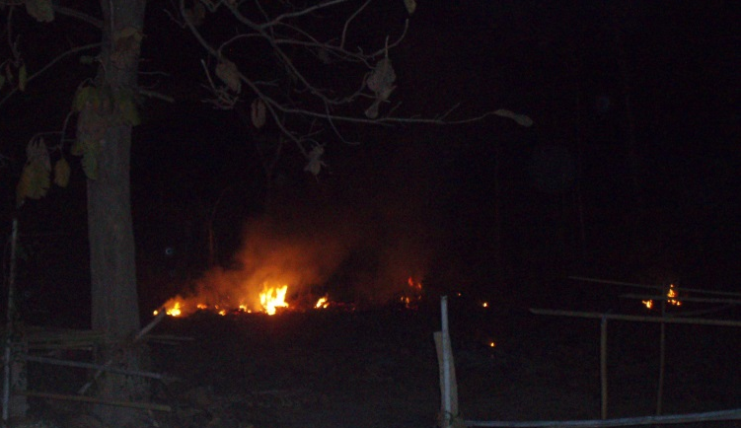
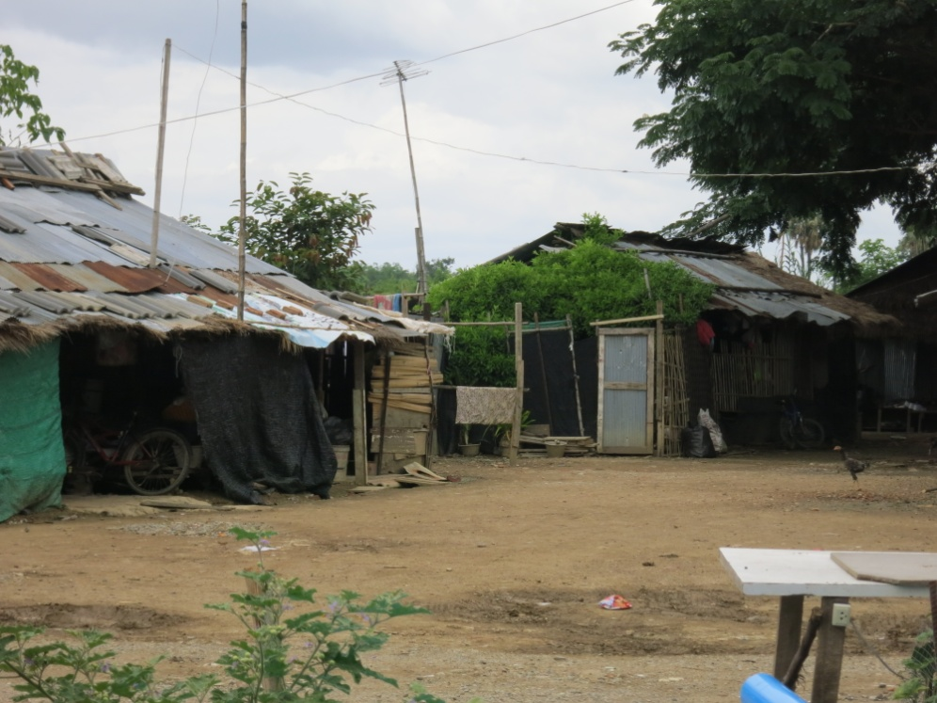
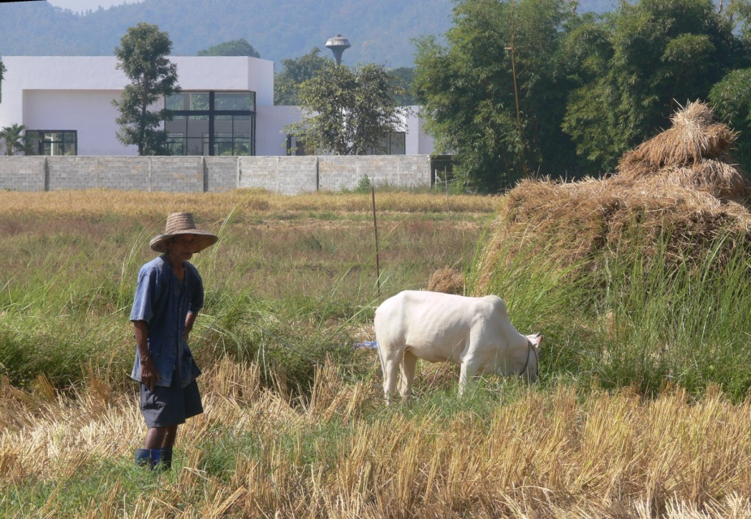
Study of class relations in the PRESENT:
New form of class encounters and conflict
当前的阶级关系研究：新形式的阶级接触和冲突
Different ways of living and values 不同的生活方式和价值观
Notes:
Study of class in the post-agrarian context
- From production to consumption
When migration brings people from different places and social backgrounds to live in close proximity, what are the value-based encounters between newcomers and locals?
Class hierarchy
Class distinction within the community but now with in-migration of urban middle class, class has become more distinct
Class mobility from within
in the past all people were farmers w/ some are labours in the farm as land was limited
During the development – migration + sold land; facility development in the area → people have been gradually out of the farm
Better economic capital during the development and change to become small entrepreneur, dormitories owners, construction contractors
education in the younger generation most of children got undergrad degree and many have master degree
some are not better and class between local people have become clearer
Class mobility from in-migration
- Not only class hierarchy within community or in the distance of class differences but now with in-migration of urban middle class, class has become more distinct
Expectations and Ambivalence of appropriate behaviours
smoke, noise, privacy, contribution to the community
นอกจากนี้การศึกษาดูได้จากการ “บริโภค” หมายถึง การใช้ชีวิต ค่านิยมการบริโภค ซื่งเป็นทั้งการแสดงตำแหน่งแห่งที่ของตน และการสื่อสารไปยังผู้อื่นด้วย เช่น ลักษณะการปลูกบ้าน รถที่ใช้ การจัดสวน ขณะเดียวกัน กลุ่มคนเดียวกันแม้ว่าจะมีการแสดงทางชนชั้นอย่างไร จะดูกันออกว่าในความเป็นจริงเป็นอย่างไร ต่างกับคนที่ย้ายเข้ามาอยู่ใหม่ที่อาจมีภูมิหลังเป็นชาวชนบท หรือคนงานธรรมดามาก่อน แต่เมื่อย้ายมาอยู่ที่ใหม่ ความสัมพันธ์กับคนกลุ่มใหม่ ก็เกิดเป็นการจัดความสัมพันธุ์ที่แปรผันไปตามบริบทและแห่งที่ด้วย

Slide 18
Study class relations in complex context
复杂社会环境中的阶级研究
Agrarian society 农耕社会
Production: land, labour, capital
生产资料：土地、劳动力、资本
Post-agrarian society 后农耕社会
Production + Consumption (lifestyles and values)生产与消费（生活方式和价值观念）
in a place 在某地？？
Notes:
Agrarian society – study of class is mainly in agrarian context that most of people involve in farming and their relations linked in one place – means of production (economic capital)
Current society – people have different occupations, mobile through places and are not directly linked but class stratification still exists and distinct and are different in each culture. Therefore, other types of capital i.e. cultural capital with economic capital. For Thai culture, place of origin, ethnicity, occupation, education
→ production + consumption (way of living, values = locating/communicating oneself to the others) + putting specific place with the study of class is crucial
Study of class in the post-agrarian context
- From production to consumption
Class mobility from within
in the past all people were farmers w/ some are labours in the farm as land was limited
During the development – migration + sold land; facility development in the area → people have been gradually out of the farm
Better economic capital during the development and change to become small entrepreneur, dormitories owners, construction contractors
education in the younger generation most of children got undergrad degree and many have master degree
some are not better and class between local people have become clearer
Class mobility from in-migration
Not only class hierarchy within community or in the distance of class differences but now with in-migration of urban middle class, class has become more distinct

Slide 19
Conclusion 结论
1. Mixture of physical and social landscapes in peri-urban zone 郊区具有混杂的物质和社会景观
  unclear border between urbanity and rurality but clearer class distinction 城乡边界不清晰，但阶级区隔比较明显
  2. New form of class relations and conflict in the increasingly post-agrarian context 后农耕社区中不断增长的新形式阶级关系与阶级冲突
  closer in distance but further in understanding 相闻而不识
3. Study of class and place as complexity and dynamism 阶级与地点研究中的复杂性和动态性

