Slide 1
Powers of Exclusion
Land dilemmas in Southeast Asia
Mekong Research Group
Public Lecture
Northwestern Agriculture and Forestry University, Xi’an, China
22 May 2018
Philip Hirsch, Emeritus Professor of Human Geography
School of Geosciences, University of Sydney
Notes:
Revived interest in land in SE Asia
Lull in agrarian political economy with urbanisation, industrialisation, de-agrarianisation
But new competition for land – land deals, land grabbing, 2008, and new agendas – conservation, identity politics, land beyond its agricultural return for subsistence/cash crops – new meanings
changing contexts in which land access and control is achived → changing ways in which people are excluded from land
POE

Slide 2
Revived interest in land
1

Slide 3
Revived interest in land
Beyond agrarian political economy?
Agrarian studies of the 1960s-1980s
Decline post-1989
Revival post-2008
New actors, intensified competition, new processes… new concepts
Notes:
Revived interest in land in SE Asia
Lull in agrarian political economy with urbanisation, industrialisation, de-agrarianisation
But new competition for land – land deals, land grabbing, 2008, and new agendas – conservation, identity politics, land beyond its agricultural return for subsistence/cash crops – new meanings
changing contexts in which land access and control is achived → changing ways in which people are excluded from land
POE

Slide 4




Revived interest in land
Land initiatives
“… a global and independent land monitoring initiative that promotes transparency and accountability in decisions over land and investment”
“Securing family farmers and communities access to land and natural resources in the Mekong Region”
“…works to help partners to create, curate and disseminate land governance data and information to become part of a more inclusive, friendly and accessible information landscape”
“…the world’s largest science-led platform on sustainable land use”
Notes:
Global infrastructure of land governance initiatives.

Slide 5
Exclusion
2

Slide 6
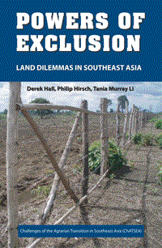
Exclusion
Exclusion, inclusion and access
Inclusion
Access: the ability to benefit from things
Exclusion:
  A condition
  A process: the ways in which people are prevented from benefiting from things
  Hence focuses on contention, power
Actors

Slide 7
Exclusion
Normalising exclusion
A normative or analytical concept?
Beyond the idea of exclusion as a “social bad”
Normalising exclusion conceptually
Structuring our understanding of exclusion

Slide 8
Exclusion
Exclusion, enclosure and dispossession
Exclusion’s conceptual cousins
  Enclosure
  Primitive accumulation
  (Accumulation by) dispossession

Slide 9
Exclusion’s double edge
3

Slide 10
Exclusion’s double edge
The double edge
Exclusion’s double-edged processes
  Maintaining existing access
  Losing access
  Preventing access
Exclusion as necessary for all land uses and tenure arrangements, for:
  Production
  Conservation
  Other objectives
Exclusion produces security and insecurity

Slide 11
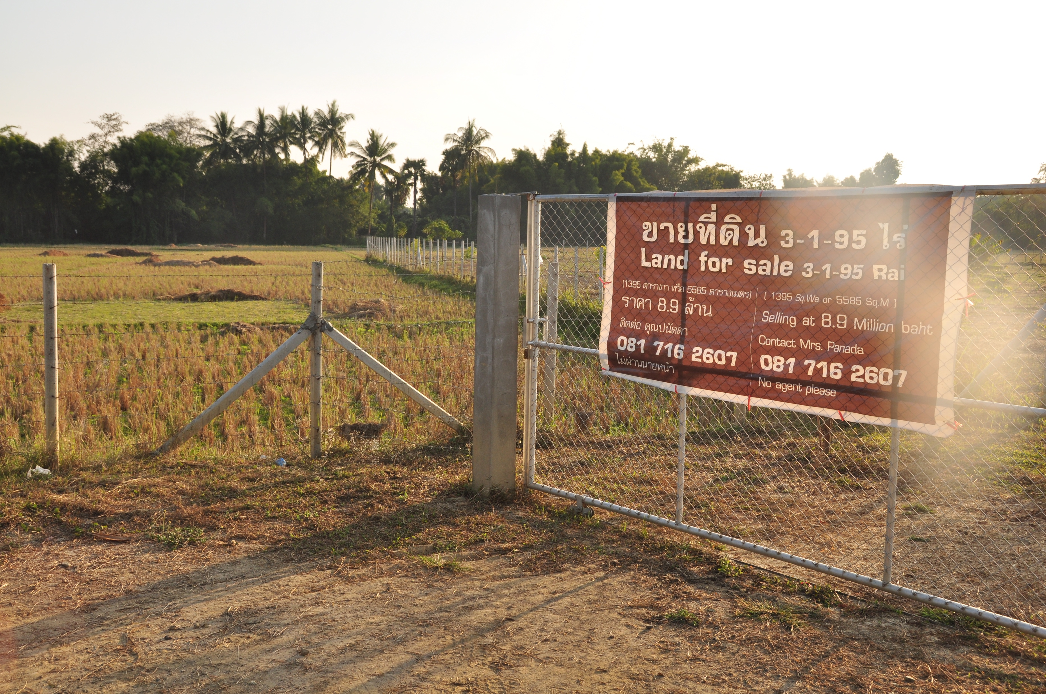
Exclusion’s double edge
Dilemmas
To entrench exclusion or keep things flexible?
To marketise or protect?
To individualise or maintain collective authority over land?
To open to market forces or to protect?
  Countermovements
etc

Slide 12
Powers
4

Slide 13
Powers
Regulation
Rules
The state as regulator
Non-state regulation and governance
The move toward formalisation

Slide 14
Powers
Markets
Prices
What is affordable?
Speculation as a driver of exclusion
Neoliberal ideology of market as optimal allocator
A leveled playing field or serving more powerful economic players?
Real estate development, Vietnam

Slide 15
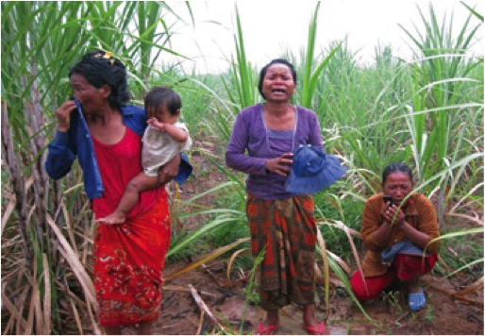
Powers
Force
Violence
Threat
State actors and the use of force/threat of force
Countervailing force

Slide 16
Powers
Legitimation
Moral claims
  Particularly important given the multiple meanings of land
Negotiation
Normative basis for the other powers

Slide 17
Processes
5

Slide 18
Processes
Land formalisation
Land titling
  Examples: Thailand
Land and forest allocation
  Example: Laos
Land reform
  Example: Philippines

Slide 19
Processes
Conservation
Protected areas
  Example: Lore Lindu, Indonesia
CBNRM
  Example: community forests in Cambodia
Investment-related offsets
  Example: Nam Theun 2 dam, Laos

Slide 20
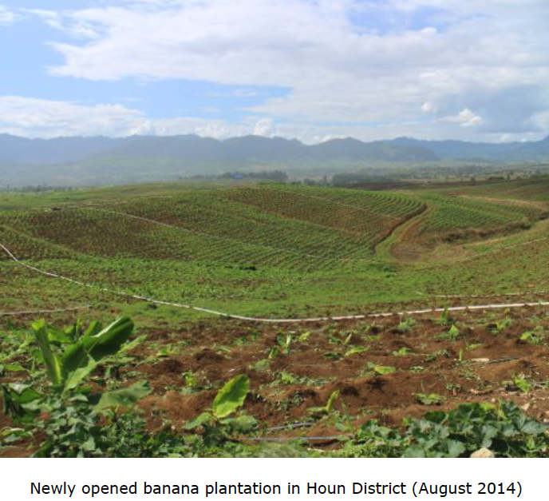
Processes
Boom crop expansion
Examples:
  Oil palm, Sarawak
  Coffee, Vietnam
  Shrimp, Thailand

Slide 21
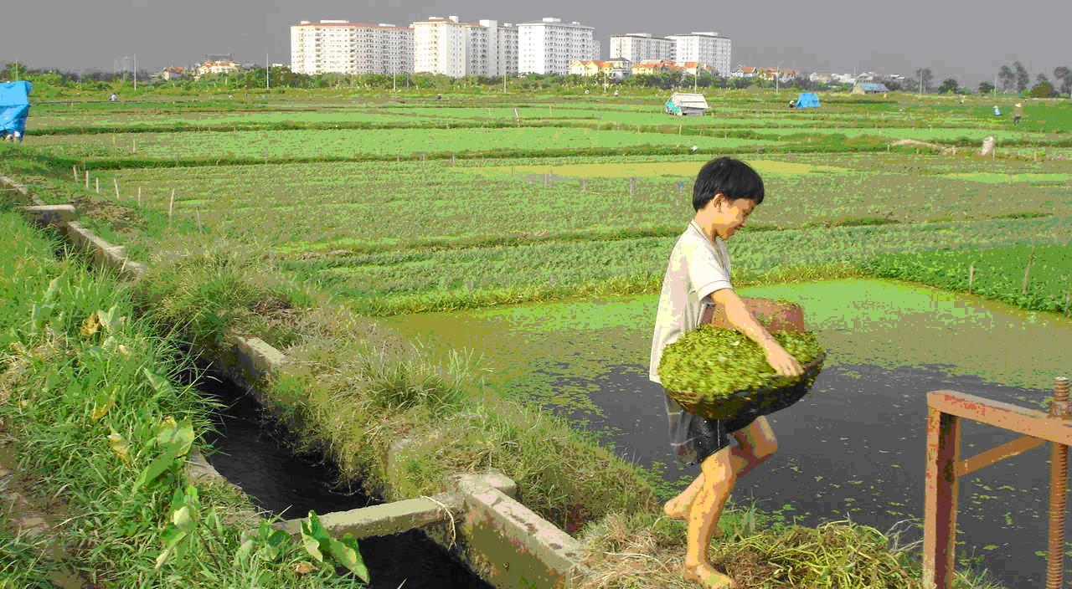
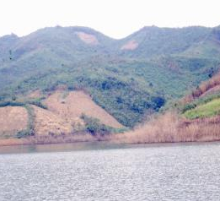
Processes
Post-agrarian land conversion
Peri-urban development
  Example: Cavite, Philippines
Tourism
  Example: Angkor/Siem Reap
Hydropower reservoirs
  Example: Hoa Binh Dam, Vietnam

Slide 22
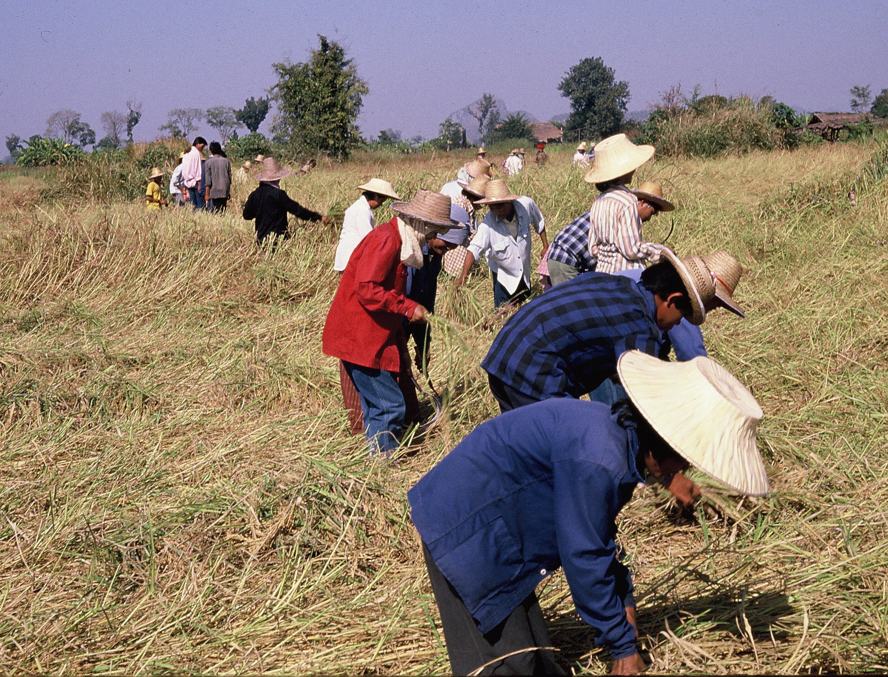
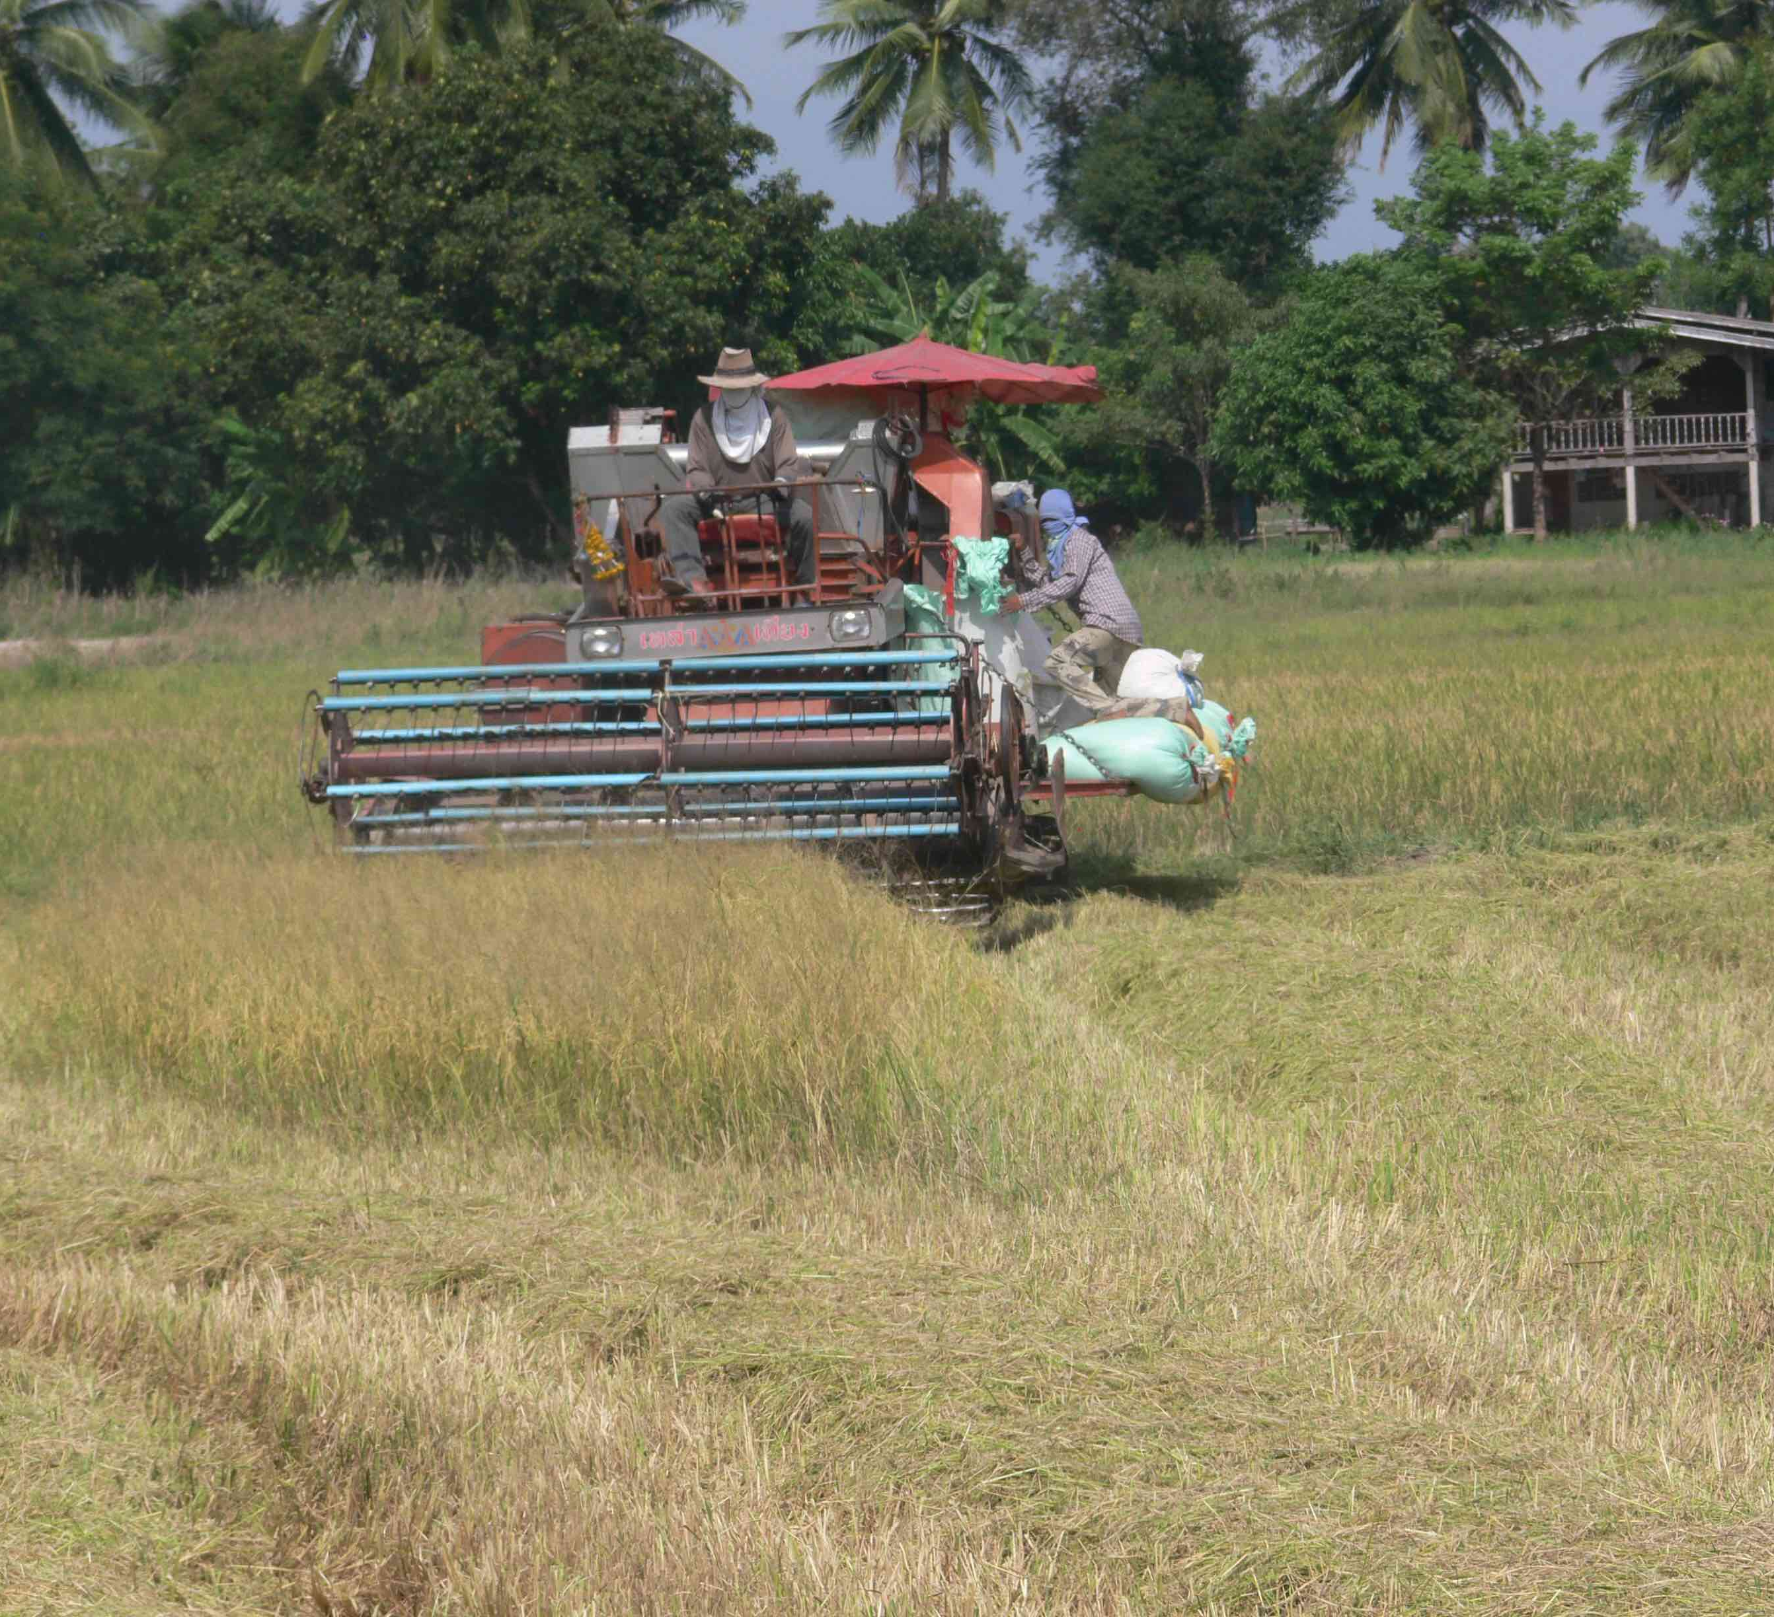
Processes
Intimate differentiation
Questioning shared poverty
  Example: Java
Enclosure
  Example: Sulawesi
Agrarian differentiation
  Example: Mekong Delta, Vietnam

Slide 23
Processes
Counter-exclusions
Indigenous claims
  Example: Philippines
Ethnoterritorial claims
  Example: Kalimantan
Right to livelihood
  Example: Indonesia
Mobilising against eviction
  Example: Assembly of the Poor, Thailand

Slide 24
Beyond Southeast Asia
6

Slide 25
Beyond Southeast Asia
Melanesia: Kastom, Property and Ideology
https://press.anu.edu.au/publications/series/state-society-and-governance-melanesia/kastom-property-and-ideology

Slide 26
Beyond Southeast Asia
Other world regions
Africa
South Asia
Latin America
  “This double-edged aspect of exclusion speaks to me as someone who works in Latin America where you have the rise of left-leaning or populist governments voted in by large-scale popular mobilizations with strong anti-neo liberal sentiment. These governments – from Venezuela to Bolivia, Ecuador, Argentina and Brazil – are having to perform a very complicated dance between the popularization of resources and appeal to the public and the necessary exclusions made in the name of progress, development and social well-being.”
          Wendy Wolford, comments from Authors meet Critics session at AAG meeting, Boston, 28 Feb 2012

Slide 27
Beyond Southeast Asia
China?

Slide 28
Thank you for your attention
philip.hirsch@sydney.edu.au

